Slide 1
Why Thailand?
Australian Embassy Bangkok
James Wise
Australian Ambassador to Thailand
March 2014

Slide 2
Thailand in Focus: Why?
Australian Embassy Bangkok
Thailand offers a range of possibilities
  outward mobility
  research collaboration
  academic exchanges
Australia generally unaware of them
New Colombo Plan
Notes:
PRESS I am doing this presentation because, first of all, Thailand offers significant opportunities for Australian universities:
For outward mobility, and
For research collaboration and academic exchanges.
PRESS Secondly, because, on the whole, Australian universities are unaware of these opportunities.
There are, of course, honourable exceptions to this.
The education sector is not alone. Australia generally is under-informed about Thailand, and that includes our business community.
As a result of our low levels of understanding, our educational relationship with Thailand is one-dimensional.
It is dominated by the flow of Thai students to Australia.
Those students are very welcome, and we would like to see more of them. PRESS
The third reason I am doing this presentation is the availability of new funds for outward mobility to Asian universities - through the New Colombo Plan.
PRESS

Slide 3
Thailand: Common Views
Australian Embassy Bangkok
Good place for a holiday
Poor and undeveloped
  So education is not high quality
Language Barrier
Political Instability
  Is it safe?
Notes:
Let’s have a quick look at common Australian views of Thailand. PRESS
Yes, Thailand is a good place for a holiday. Last year Thailand received almost 27 million tourists – up from 22 million in 2012.
But Thailand is more – much more – than just a good place for a holiday.
PRESS Australians still also tend to think of Thailand as a poor, under-developed country.
And, because of that misperception, we also tend to think that education there is not of a high quality.
In brief, this is rubbish. In purchasing power, Thailand is the 24th biggest economy in the world (Australia is the 18th biggest).
Thailand is the second-biggest economy in ASEAN.
Thailand’s economy is also sophisticated. Parts of its economy are world class and surpass Australian standards.
The size and sophistication of Thailand’s economy owes a lot to the ease of doing business there.
The World Bank ranks Thailand as the 18th easiest place to do business in the world. Just ahead of Canada and Germany.
As you will see, this ease of doing business in Thailand applies equally to the business of education, especially in outward mobility.
PRESS Australians also think of Thailand as a place where English is not widely spoken.
PRESS Or we worry that Thailand’s periodic instability means that Thailand is unsafe.
Let’s have a closer at these language and security questions.
PRESS

Slide 4
But I don’t speak Thai ….
Australian Embassy Bangkok
Language not a barrier in university sector
TESOL opportunities
Notes:
PRESS While English is not as widely spoken in Thailand as in some other ASEAN countries, more and more Thais are speaking English and more and more are speaking it well, especially in the university sector.
Business people with broad regional experience tell us that in terms of English language communication Thailand is well ahead of places like Japan, Korea, China and Vietnam.
In brief, at the university level, there is no language barrier.
PRESS The Thai Government has made boosting English language skills a national priority, not least because English is the language of ASEAN and the ASEAN Economic Community is just around the corner.
That offers great opportunities for Australian institutions specialising in the teaching of English.
PRESS

Slide 5
Is Thailand Safe?
Australian Embassy Bangkok
Yes, it is
  Personal safety risks are very low
Politics does not disrupt education
Easy to avoid trouble
Notes:
PRESS Personal safety is not an issue in Thailand. If it was, Thailand would not have attracted almost 27 million tourists last year.
Thailand’s periodic political instability should not deter Australians from exploring opportunities in Thailand.
PRESS Political disturbances over the last eight years have rarely disrupted educational institutions.
PRESS Nor have political disturbances affected the security of anyone who stays away from political demonstrations, which take place in very few, geographically small and easy-to-avoid places.
PRESS

Slide 6
Thai Universities
Australian Embassy Bangkok
100 top Asian universities (THE 2012)
  6 in ASEAN
  3/6 in Thailand: KMUTT, Mahidol, Chulalongkorn
KMUTT ranked ahead of 24 Australian universities
Thai universities are independent
  best approach = direct approach
Thai universities are internationalising - fast
Notes:
I mentioned earlier that many Australians still have a low opinion of the quality of Thai universities. I think that, regrettably, this is also the view in many of our university faculties. Let’s have a look at that.
PRESS In the Times Higher Education 2012-13 rankings of the top 100 Asian universities, six were in ASEAN countries.
How many of those six are in Thailand?
PRESS Half of them. (Of the other three, two are in Singapore, one in Malaysia).
55 KMUTT, 61 Mahidol, 82 Chulalongkorn (87 UKM)
PRESS In the THE 2013 ratings, Thailand’s top university, KMUTT, jumped 40 places to 349th spot – placing it ahead of 24 Australian universities, i.e. ahead of 62% of Australian universities.
PRESS Thai universities – public and private – are highly independent.
They are responsible for their own decision-making, and for their own international partnerships.
So Australian universities wanting partnerships with Thai universities do not need to go through government or through some other coordinating body.
PRESS Finally, Thai universities are internationalising. And they are doing it quickly.
PRESS

Slide 7
Internationalisation
Australian Embassy Bangkok
Growing number of joint degrees
  92 (2011)
Growing number of international programs
  > 1,000 (2012)
> 20,000 international students (2011)
  11,000 (2007)
Branch campuses
Notes:
PRESS In 2011, Thailand had an estimated 92 collaborative degree programs, or what Australians usually call joint degrees.
Between 2009 and 2011, these grew by more than 50 per cent.
The biggest growth was in masters programs, which jumped from 14 to 36.
PRESS In 2012, Thai universities, including all of the nine national research universities, offered just over 1,000 international programs.
In 2006, the number was just over 700.
PRESS Thailand already has over 20,000 international students. The numbers are growing quickly. Thailand wants more.
PRESS Two universities from the United States – Stamford and Webster – have already established branch campuses in Thailand. The University of Lancashire is currently doing so.
I think Australian universities should explore the possibility of establishing a branch campus in Thailand. There is probably no time to discuss this today, but I would happy to do so later in anyone is interested.
PRESS

Slide 8
Joint Degrees
Australian Embassy Bangkok
Rules are comparatively simple
Currently nine Thai-Australia programs, e.g.
  UOW and Assumption– B.Comm
  UOW and KMUTT– B.Eng (Environmental Eng.)
  UTS and Mahidol – Ph.D. (Science)
Notes:
PRESS In Thailand the rules for joint degree programs are comparatively simple, especially compared with places like China.
Put simply, the two universities must reach an agreement on the design and structure of the joint degree program and sign a partnership document.
The Thai university must advise the Thai Government of the program, which the Thai Government will then acknowledge.
As noted earlier, Thai universities have a lot of independence.
PRESS Currently there are nine joint degree programs between Australian and Thai universities. I’ve put some examples on the slide.
UOW has a 2+2 joint Bachelor degree program in Commerce with Assumption University. This is one of the most successful and long established joint degree programs between a Thai and Australian university. It was founded more than 10 years ago.
In 2012 UOW signed an agreement on a 2+2 Bachelor degree program with Faculty of Engineering (Environmental Engineering), KMUTT.
UTS and the Faculty of Science, Mahidol University, have established dual PhD Program & research student exchange agreement. The first dual doctoral student from Mahidol spent 15 months at UTS from Nov 2011 - Feb 2013.
PRESS

Slide 9
International programs
Australian Embassy Bangkok
> 1,000 international programs (2012)
Wide variety of courses
All levels
  ≈ 350 bachelors
  ≈ 400 masters
  ≈ 250 doctoral
Notes:
PRESS As mentioned before, Thailand has more than 1,000 international programs in English.
PRESS International programs are offered in many courses, including law, science, medicine, arts, engineering and business studies.
PRESS They are also offered at all levels, with approximately 350 bachelor courses, 400 at masters level, and 250 doctoral level.
PRESS

Slide 10
Student Mobility: Numbers
Australian Embassy Bangkok
> 20,000 international students (2011)
  11,000 (2007)
≈ 9,000 from China
Neighbouring countries heavily represented
But look at EU, US, Japan, Korea too ….
Notes:
PRESS As mentioned a moment ago, Thailand already has over 20,000 international students. According to the Ministry of Education, these students are enrolled for a semester or more.
PRESS Almost 9,000 of them are from China.
PRESS Most of the rest are from neighbouring countries.
PRESS Let’s have a look at how Thailand compares with other ASEAN countries as a destination for international students from selected countries.
Unfortunately, Singapore does not release data to UNESCO, the source of our statistics.
But we have information on the other major ASEANs: Indonesia, Malaysia, Vietnam, Philippines and, of course, Thailand
PRESS

Slide 11
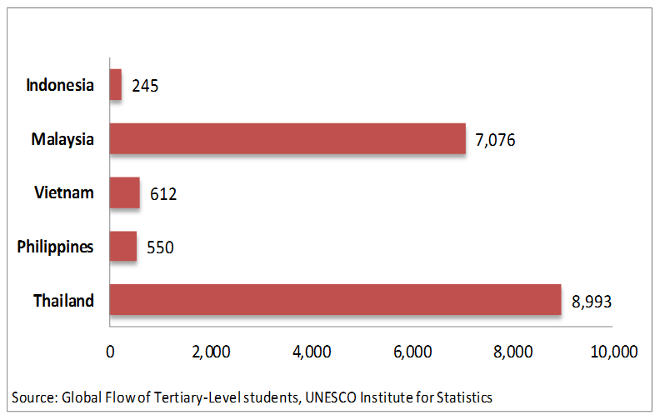
Where are Chinese going…?
Australian Embassy Bangkok
Notes:
Let’s start with China, because China’s numbers are usually astounding.
PRESS Which country is attracting the most Chinese students? Thailand.
PRESS

Slide 12
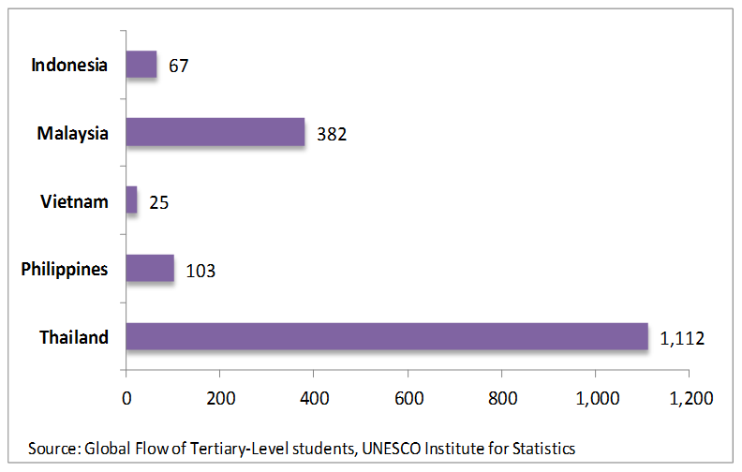
Where are Europeans going…?
Australian Embassy Bangkok
Notes:
PRESS
Which country is attracting the most Europeans students? Thailand.
PRESS

Slide 13
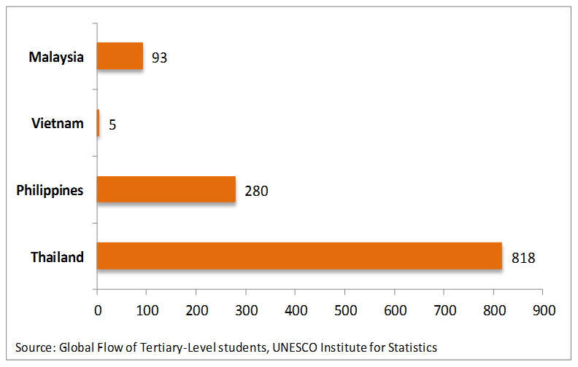
Where are Americans going…?
Australian Embassy Bangkok
Notes:
PRESS
Which country is attracting the most American students? Thailand.
PRESS

Slide 14
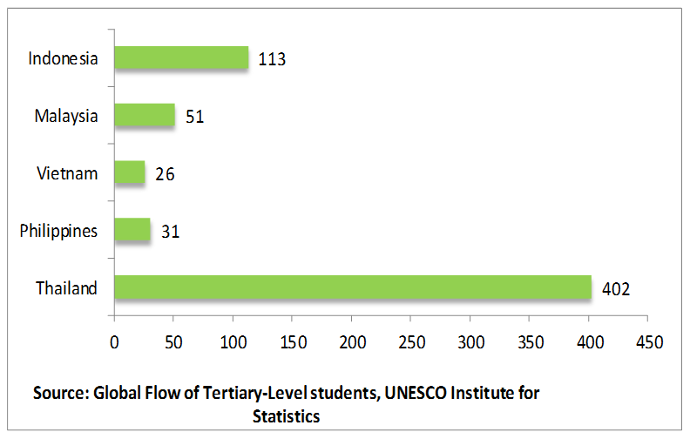
Where are Japanese going…?
Australian Embassy Bangkok
Notes:
PRESS
Which country is attracting the most Japanese students? Thailand.
PRESS

Slide 15
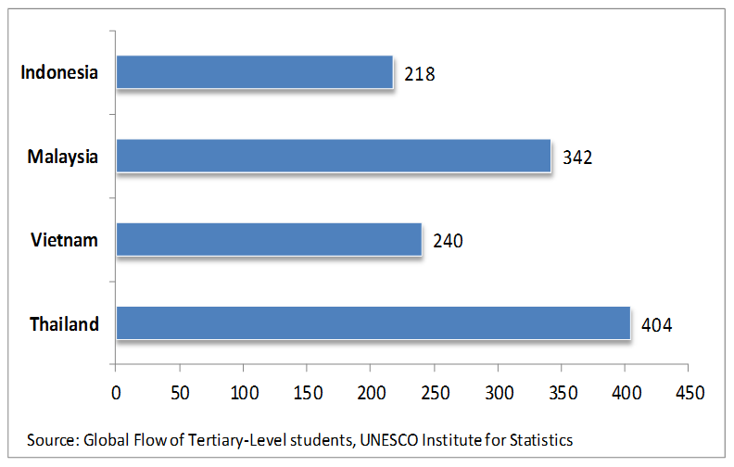
Where are Koreans going…?
Australian Embassy Bangkok
Notes:
PRESS
Which country is attracting the most Korean students? Thailand.
PRESS

Slide 16
Student Mobility: Why Thailand?
Australian Embassy Bangkok
Good quality universities
  Accustomed to international students
  Tailor programs to suit students
  Recognition of credits straightforward
Internships not difficult
Easy visa regime – for students and interns
Notes:
Thailand is popular with international students – and their home universities – because:
PRESS Thai universities have good academic standards
PRESS They have a strong track record in dealing with foreign students
PRESS They are happy to tailor programs to suit student needs
PRESS Transfer of credits is quite straightforward
PRESS Internships are also fairly straightforward in Thailand, much more so than seems to be the case in many other places.
Internships can be arranged either through a Thai university or through the company that is hosting the intern.
Students who undertake an internship through a Thai university usually remain on a student visa. PRESS
Interns who are not connected to a Thai university usually get a business visa, which is relatively simple.
Thailand has a designated study visa for foreign students, called the ED visa. We have not heard any reports of problems with this visa.
PRESS

Slide 17
Student Mobility: Pastoral Care
Australian Embassy Bangkok
Airport transfers
Clean, secure accommodation
Visa facilitation
Excellent medical facilities
Notes:
Thailand’s well-deserved reputation for courtesy and hospitality, which underpins its tourism industry, is also a feature of the attitude of Thai universities towards foreign students.
PRESS Foreign students are met at the airport.
PRESS Their Thai university will help them find clean, secure accommodation either on the campus or close by.
I have visited residential accommodation for students at many Thai universities. It is spotless.
Food of the highest standard – in terms of hygiene as well as taste – is available very easily, and very cheaply.
PRESS If a foreign student has arrived on a tourist visa – a common occurrence – the Thai university will help arrange a student visa for them, which is easy to do.
PRESS If a student needs medical treatment, first rate facilities are available.
Private medical facilities are world-class. Government facilities are generally of a high standard.
PRESS

Slide 18
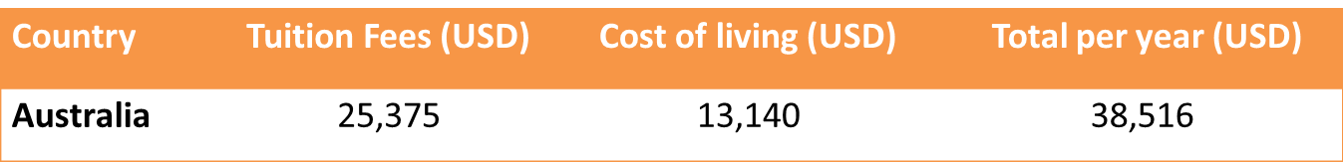
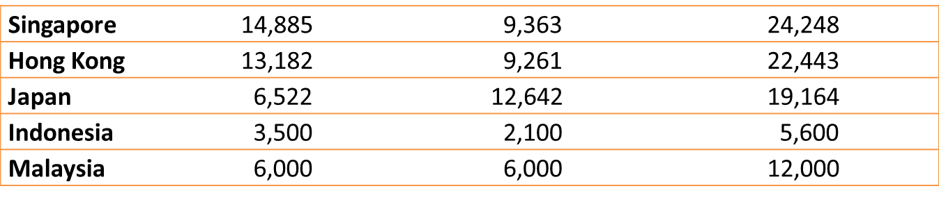
Student Mobility: Cost
Australian Embassy Bangkok
Average annual cost for international students
Notes: Tuition fee based on general study disciplines: business, IT, Engineering, social sciences, arts, communication.
Thailand’s annual tuition fee will be less in regional universities.
Source: HSBC research Aug 2013: Review data on higher education in 13 countries
www.studyinthailand.org
Thailand: A Study Abroad for Australian Students Guidebook by AEI
Notes:
This table gives you an idea of indicative costs.
The data is drawn from HSBC’s research on the cost of higher education in 13 countries.
Unfortunately, Thailand was not included in the HSBC survey, so we have done our own estimate for likely costs in Bangkok and in regional centres, where costs would be much lower.
As you can see, Thailand is very competitive.
PRESS

Slide 19
Student Mobility: Examples
Australian Embassy Bangkok
UTS and Phranakorn Rajabhat University
  Teaching practicum – 12 students last July
SCU and Naresuan University
  Cultural study and English language training
Deakin University and KMUTT
  Cross-Asia architectural experience
(Very) few semester-long experiences – yet!
Notes:
A few examples of student mobility arrangements in Thailand involving Australian universities.
PRESS UTS has a longstanding arrangement with Phranakorn Rajabhat University, a specialist teacher training university in Thailand. Last July 12 UTS students undertook a teacher practicum at schools associated with Phranakorn.
In September last year, I met two fourth-year engineering students from UTS at KMUTT, where they were involved in a robotics project with Thai students.
PRESS At the beginning of last year I met some students from Southern Cross University at Naresuan University in Phitsanulok, a provincial town a few hours north of Bangkok. The SCU students were studying Thai culture as well as providing Naresuan University students with highly valued exposure to native English speakers.
A few months later I spent a couple of days on another Naresuan-related program – on that occasion, with students from UWA who were from a range of environment-related disciplines.
PRESS Deakin brought a group of architecture students to KMUTT early last year – to study local architectural practices. The program started in Malaysia, has now been extended to Thailand, with a view to including Indonesia, Vietnam and India in the future.
PRESS So far, we have had very few Australians come to Thailand for semester-long or even longer experiences. But we have had some.
Early last year, with the support of the Australia Thailand Institute, nine Australian students spent a semester in Thailand. They were from QUT, La Trobe, Griffith, RMIT, UTS, Flinders, University of Canberra, Uni SA, ANU.
Their Thai partners were Chulalongkorn, Mahidol, KMUTT, Thammasat, Chiang Mai.
We are confident that there will be more in the future. If Europeans, Americans, Japanese and Koreans can do it in their hundreds, why can’t Australians?
PRESS

Slide 20
New Colombo Plan: Aim
Increase the number of Australian students in Asia
  study
  internships
2014 pilot program
  Hong Kong, Indonesia, Japan, Singapore
2015 – full implementation
Wide range of disciplines
Notes:
PRESS The New Colombo Plan has a simple aim: to increase the number of Australian undergraduates studying and/or undertaking internships in Asia.
PRESS This year the Plan is being piloted in Japan, Singapore, Indonesia and Hong Kong.
The pilot phase will provide 40 scholarships as well as grants for some 700 students. To date, 24 Australian universities have received funding under the scheme.
PRESS The NCP will be extended to the rest of the Asian region next year. This year, therefore, I would recommend that you identify good Thai partners.
PRESS Under NCP, the study opportunities can be across a wide range of disciplines from law, health and education, language and culture, to science, technology and engineering.
For example, in Indonesia under the pilot program, engineering students will undertake internships with leading Indonesian and international companies; veterinary students will learn about the Indonesian beef industry; and economics students will learn about the property market.
PRESS

Slide 21
NCP: Funding & Eligibility
$100 million (5 years)
Funding covers:
  host institution fees
  two-way travel
  living stipend
  insurance
Open to Australian undergraduates
  18 to 28 years
  studying at an Australian university
Credit recognition is essential
Notes:
PRESS NCP has been allocated $100 million of new funding over five years.
PRESS The Plan will meet all the students funding requirements, except for HECS.
PRESS It is available for undergraduates between 18 and 28 years studying at Australian universities.
PRESS Please note the final point: credit recognition for the course of study or the internship is essential. In other words, to enable your students to study in Thailand in 2015, you should be looking at credit recognition arrangements with Thai universities fairly soon.
PRESS

Slide 22
NCP: Access
NCP is demand driven and flexible
Step 1: design a program with a partner in Asia
Step 2: lodge an application
Notes:
PRESS New Colombo Plan programs are flexible and demand-driven.
PRESS As a first step, An Australian university should design a mobility program with a partner organisation in Asia. (I recommend Thailand!)
PRESS Then the Australian university should lodge an application with the NCP Secretariat.
PRESS

Slide 23
NCP: Internships & Mentorships
Internships and mentorships – a high priority
  Work-ready students
  With professional connections in Asia
Strong interest from companies in Thailand
Can the Embassy help?
Notes:
PRESS The Government is particularly keen to promote internships and mentorships under the New Colombo Plan. They want students to be job-ready at home and in the region.
Internships are a monitored work or volunteer experience, offering students the chance to test their skills in real-life situations, explore career options and gain insight into an organisation
Internships could range from a few weeks to a year of work, be unpaid or paid, undertaken full-time (e.g. during a semester break) or part-time (during a course of formal study).
A mentorship is a personal development relationship, whereby a more experienced person, for example a business professional or academic, helps to guide a student in their work or career.
PRESS I would be interested in your experience with internships.
An AEI-sponsored survey (2012) showed that around round 100 member companies of Austcham had internship opportunities available, with many in the areas of engineering, law, finance and hospitality.
PRESS How do we get Australian universities linked to these companies? I would also be interested in what sort of support the embassy could provide you in this area.
PRESS

Slide 24
Other Mobility Programs
Asiabound Grants Program
The International Student Exchange Program (ISEP
Study Overseas Short-term Mobility Program)
VET Outbound Mobility Program
Endeavour Scholarships/Fellowships
Notes:
There are several other existing programs which support Australian students to have study experiences overseas. These include:
PRESS Asiabound Grants Program, which provides $2,000 or $5,000 grants for Australian students to participate in a study experience in Asia. Students are able to undertake short-term mobility for a variety of experiences including practicums, clinical placements, research trips or volunteer projects for up to six months. Students are also able to undertake semester based experiences for one or two semesters. In addition to study grants, Asiabound offers grants of $1,000 for preparatory Asian language study that can be undertaken prior to or concurrently with an approved mobility project.
PRESS The International Student Exchange Program (ISEP), which aims to strengthen partnerships between Australian higher education providers and partner institutions overseas. The program provides grants for Australian students to undertake one or two semesters overseas study at a partner institution in an eligible country. The key features of the student exchange arrangements that underlie ISEP are tuition fee waiver and credit transfer.
PRESS Study Overseas Short-term Mobility Program, provides funding to eligible higher education institutions in Australia to subsidise the costs to students and staff participating in outbound short-term mobility experiences of up to six months.
PRESS VET Outbound Mobility Program, provides funding to eligible Australian Registered Training Organisations to subsidise the costs to students and staff participating in outbound short-term mobility experiences of up to six months. I’ve included the VET program because I understand quite a few universities have strong links with VET providers.
Application rounds for all of these programs are expected to open in April this year.
Scholarships
PRESS Endeavour Scholarships and Fellowships: Endeavour Scholarships and Fellowships are available for Australians to undertake study, research and professional development overseas. There are currently four Australians undertaking Endeavour Scholarships and Fellowships in Thailand. I would encourage your university to think about these scholarships for your students. Applications for the 2015 scholarships will open in April 2014.
PRESS

Slide 25
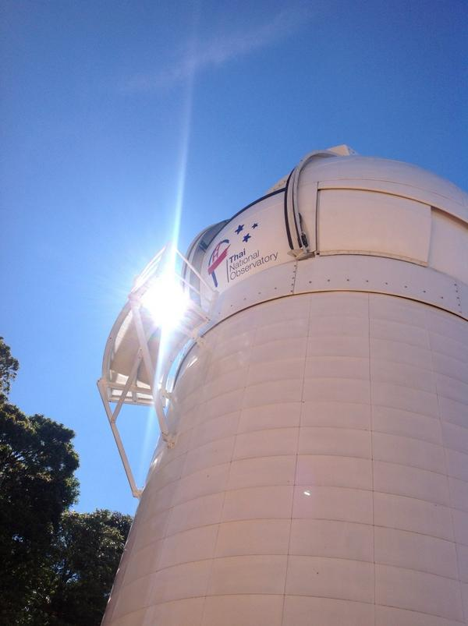

Science and Research
Australian Embassy Bangkok
Nine National Research Unis
Quantitative Goals for
R & D
Thailand Science and Research
National Science Park
Notes:
Thailand is lifting its science and research capacity.
PRESS In 2009 it designated nine National Research Universities and gave them additional funds to undertake research and to increase the research capacity of their staff, including by lifting the proportion of staff with PhDs – a wonderful opportunity which some Australian universities are taking up.
The Thai Government has issued plans for the development of science and technology, and assigned quantitative goals to these plans PRESS
including increasing the ratios of research and development staff, enhancing research intensity and increasing the amount of private funding for R&D.
A National Science Park has been established in Bangkok. It is the headquarters of the National Science and Technology Development Agency PRESS
which hosts other research agencies, like Nanotec and Biotec.
Thai companies with an interest in R&D are being encouraged to locate themselves in the Science Park.
Thailand is also investing in scientific infrastructure. It has built an Observatory in Northern Thailand PRESS
which houses the Thai National Telescope, one of the largest in South-East Asia.
PRESS The only synchrotron in South-East Asia is at Suranaree University of Technology in Khorat.
PRESS

Slide 26
Science and Research - Bilateral
Australian Embassy Bangkok
Scholarships offer (missed) opportunities
  OCSC
  Royal Golden Jubilee
Examples of collaboration
  Flinders University and Nanotec
  QUT and NSTDA
Notes:
PRESS Thailand has two Government scholarship schemes that offer great opportunities for Thai researchers to come to Australia:
Office of the Civil Service Commissioner (4,100 scholars)
Royal Golden Jubilee PhD Program (3,600 scholars)
The proportion of Thai students choosing to come to Australia under the OCSC scheme is very low: just over 4 per cent
c.f. USA (33%); UK (32%); Japan (7%); Germany (6%)
We do slightly better under the Jubilee program – 9 per cent
UK (9%); US (33%); Japan (15%)
Australian universities and academics need to make would-be Thai scholarship-holders and the OCSC better aware of opportunities in Australia.
In conclusion, let’s have a look at two examples of current scientific collaboration between Australia and Thailand.
PRESS Flinders University has an active partnership with Nanotec, Thailand’s nanotechnology research institute. This involves collaborative research, researcher exchange and joint seminars.
PRESS Under the auspices of the National Science and Technology Development Agency, QUT is forming multi-partner relationships with Thai institutions like KMUTT, Mahidol University and the Nectec research institute.
PRESS

Slide 27

THANK YOU
Australian Embassy Bangkok
Australian Embassy, Bangkok: watinee.kharnwong@dfat.gov.au
NCP Secretariat: Kate Fitzgerald 02 6261 2672
Ruth O’Hagan 02 6261 2353
ncp.secretariat@dfat.gov.au

